Slide 1
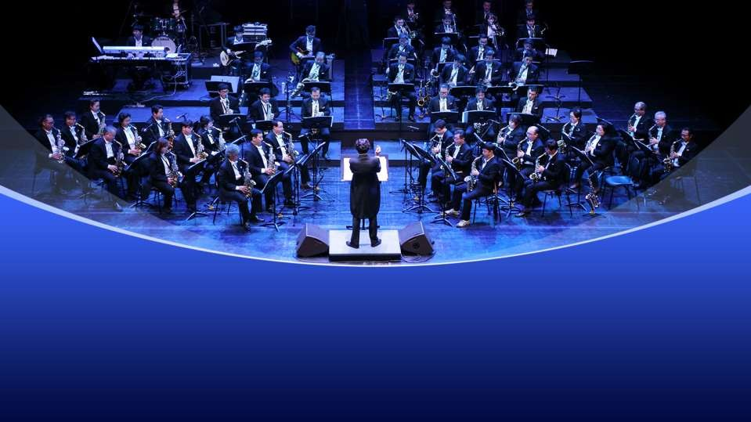

Deborah Cowley’s
Class IX PROSE
The Sound of Music

Slide 2

Part-1
The Sound of Music
This part of the story is about a Scottish girl, named Evelyn. She was very fond of music. She lost her hearing power at a young age.
It was first noticed when she was eight years old. By eleven years, she was completely deaf, due to nerve damage.

Slide 3
The Sound of Music
Evelyn Glennie didn’t give up hope and never looked back.
She was determined to lead a normal life and pursue her interest in music. Once she saw a girl playing xylophone and decided to play it. Most of the teachers discouraged her but percussionist Ron Forbes encouraged her.
He made her learn music, by making her feel different notes in her body.

Slide 4
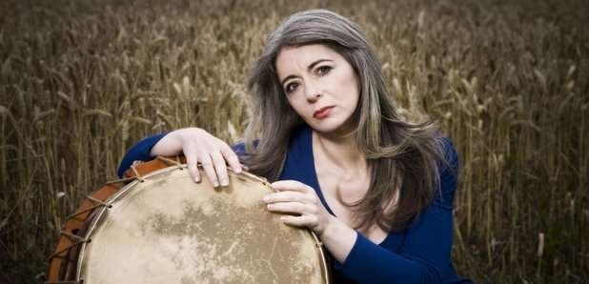
The Sound of Music

Slide 5
The Sound of Music
The rest was sheer determination and hard work. She travelled the United Kingdom with a youth orchestra and by the time she was sixteen.
She had decided to make music her life.
She auditioned for the Royal Academy of music and scored one of the highest marks in the history of academy.

Slide 6
The Sound of Music
She gradually left orchestral work and started giving solo performances. At the end of her three years’ course, she had received most of the top awards.
She explains that music flows through every part of her body. It tingles in the skin, her cheekbones and even in her hair.

Slide 7
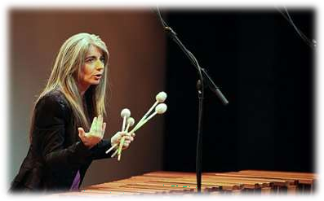
The Sound of Music
When she plays the xylophone, she can sense the sound passing up the stick into her fingertips. By leaning against the drums, she can feel the
resonances (sounds) flowing into her body.

Slide 8
The Sound of Music
On a wooded platform, she removes her shoes so that the vibration pass through her bare feet and up her legs.
Evelyn is a perfect example that disability can not stop a person to achieve if she is determined and works hard towards it. She earned many awards. She had given enormous pleasure to millions.

Slide 9
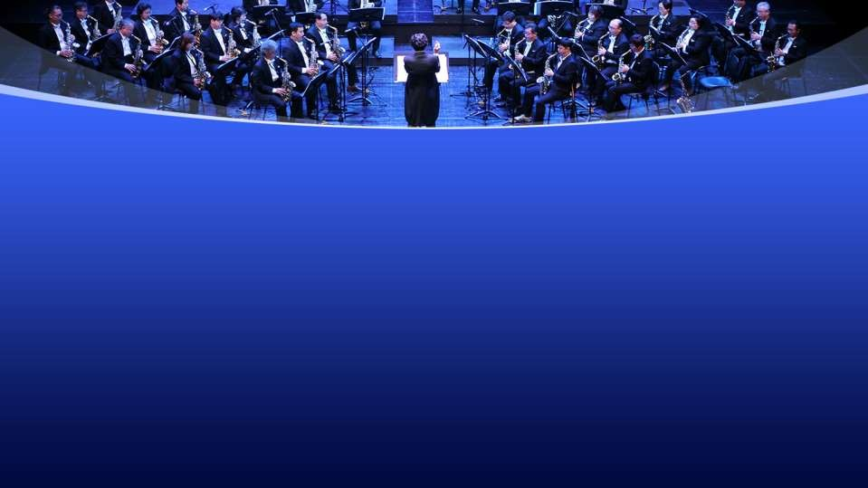





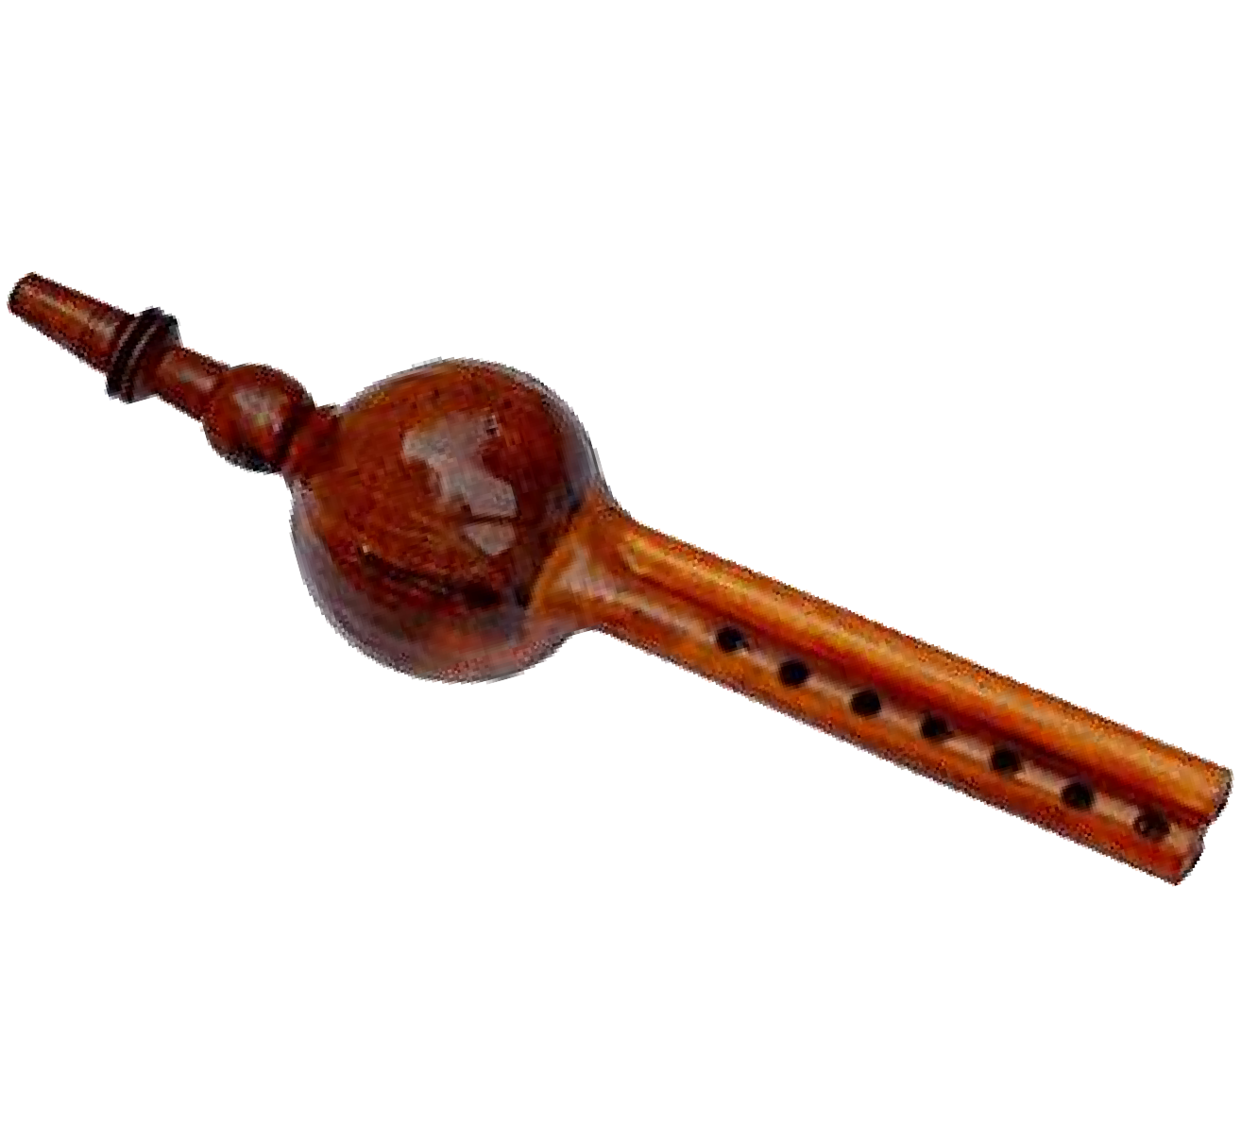
Part-2
A musical instrument called ‘Pungi’ was banned by
The Shehnai of Bismillah Khan
Emperor Aurangzeb for its shrill unpleasant sound.
It was perfected by a barber who belonged to a family of professional musicians.

Slide 10
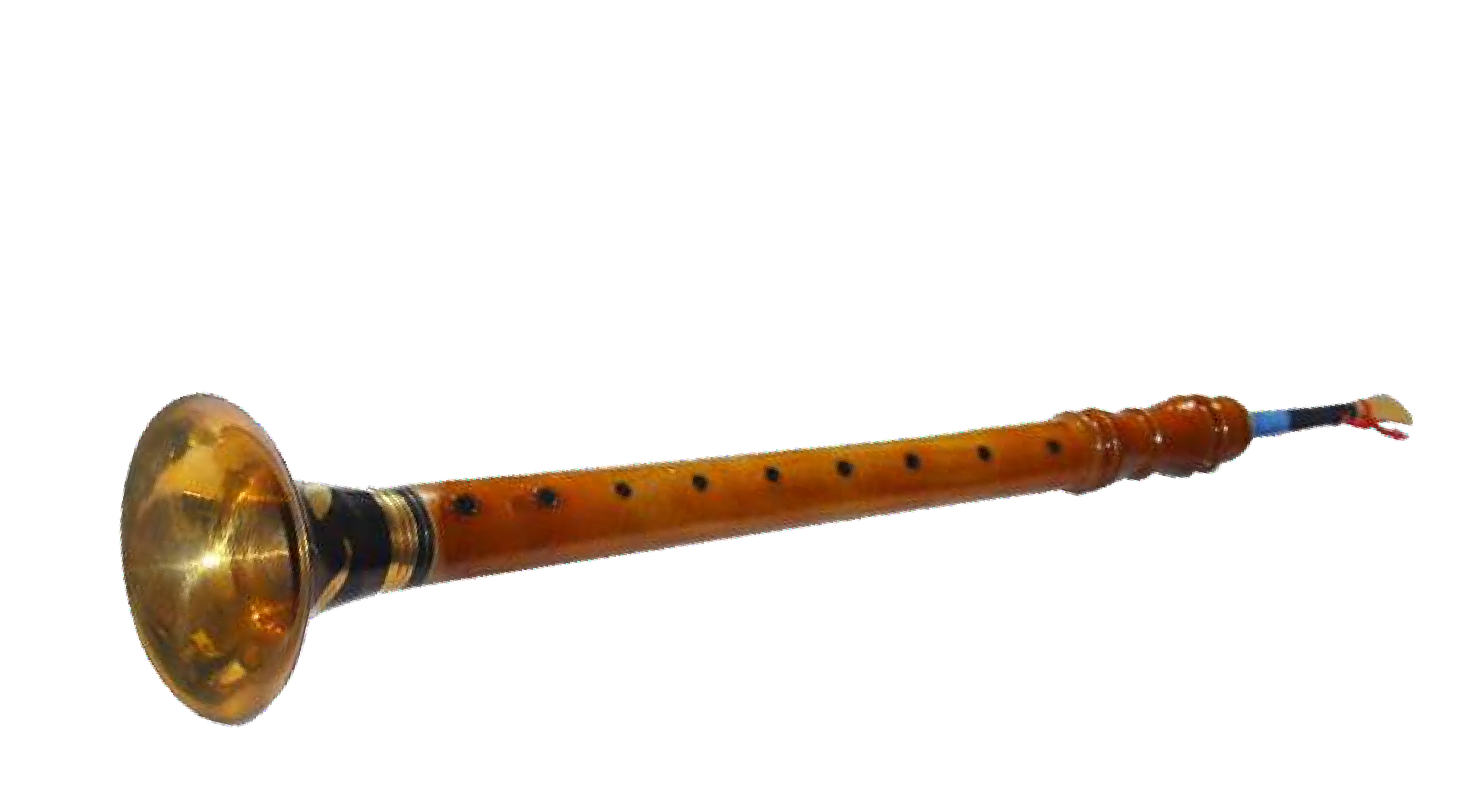
The Sound of Music
He played it in the chamber of the king. Its sound was appreciated by the emperor.
Since it was born in Shah’s chamber and perfected by a Nai, it was named ‘Shehnai’.

Slide 11
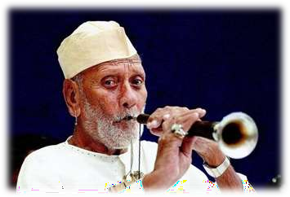
The Sound of Music
In the beginning, it was played in the temples before the images of Gods & Goddesses. It was played on every auspicious occasions too.
Gradually, it became popular.

Slide 12
The Sound of Music
Ustad Bismillah Khan belonged to the Benaras Gharana. He was born in 1916 at Dumraon in Bihar. As a five year old boy, he would play gilli-danda near a pond. He used to visit Bihariji temple and sing Bhojpuri Chaita there.
He would earn a big Laddu from a local Maharaja as a prize.

Slide 13
The Sound of Music
At the age of six, he moved to Benaras. His uncle, Ali Bux introduced him to the nuances of playing Shehnai. He was deeply devoted to music. He used to spend most of his time practising on the bank of the river Ganga. The themes of his music are deeply affected by the flowing water of the Ganga.

Slide 14
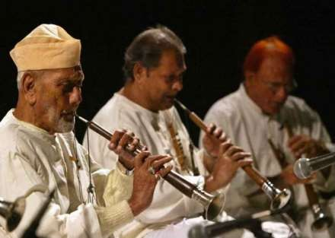
The Sound of Music
He got the best performer award at the All India music Conference in Allahabad in 1930. In 1937, he bagged 3 medals at a music conference in Calcutta.

Slide 15
The Sound of Music
He was invited by Pandit Nehru to play the Shehnai from the ramparts of Delhi’s Red Fort in 1947.
He won many international awards as well.
He loved Benaras and Dumraon. He declined an offer from one of his students to settle in the United States.
He ventured in films too.

Slide 16
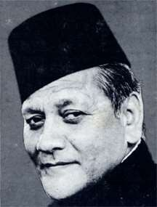
The Sound of Music
He gave his music in two movies.
But the artificial world of Cinema could not attract him.
For him, music is God. Music is his soul.

